Slide 1
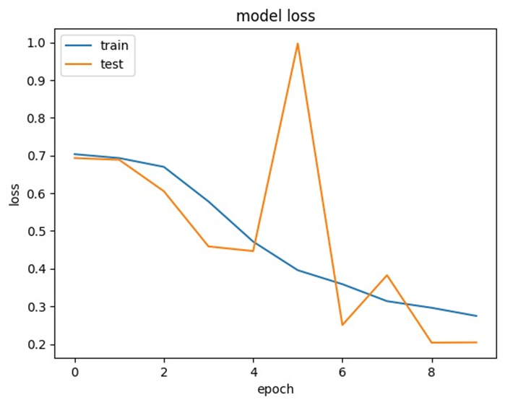
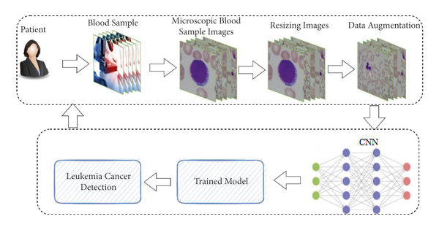
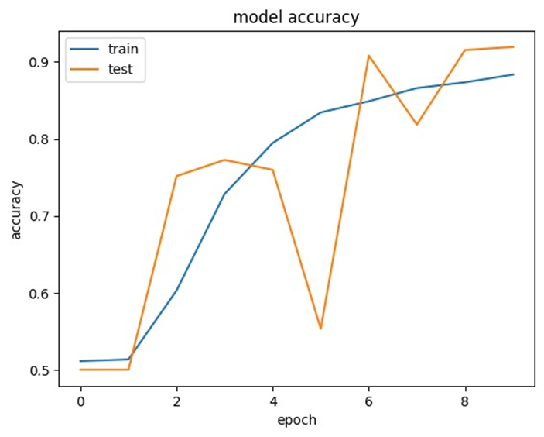
KJSIT-IET INTECH 2K23 National Level Poster cum Project Competition
Identification of Leukemia from Microscopic Images Using CNN
Burhanuddin Dilshad, Viraj Gholap, Mehul Prajapati, Prof. Prashant Sawant
ABSTRACT
SYSTEM DESIGN & ARCHITECTURE
RESULTS
Leukemia (blood cancer) begins in the bone marrow and causes the formation of a large number of abnormal cells. The most common types of leukemia known are Acute lymphoblastic leukemia (ALL), Acute myeloid leukemia (AML), Chronic lymphocytic leukemia (CLL) and Chronic myeloid leukemia (CML).
This project makes an effort to devise a methodology for the detection of Leukemia using image processing techniques, thus automating the detection process. Our project consist of
development of a machine learning algorithm to detect
cancer using microscopy image.
INTRODUCTION
Leukemia accounts for more than 3.5% of all new cancer cases in the United States, where more than 60,000 new cases were recorded in 2018. Malignant white blood cells, or lymphoblast, travel through the blood to other organs such the spleen, brain, liver, and kidneys before spreading to critical body tissues. Hematologists in cell transplant facilities can distinguish between several forms of
leukaemia based on microscopic images. Some kinds of leukaemia can be separated and detected more quickly than others if the slide is
appropriately stained, but more tools are required to identify underlying leukaemia. Our body's immature white cells begin attacking other cells when the quantity of these cells rises. A genetic issue accumulation and other pathological changes are typically the causes of the deadly illness cancer. The fatal abnormal growths known as cancerous cells can appear everywhere in the body. Convoluted histories, insufficient diagnoses, and inefficient therapies are some of the most important problems, even if each method has its own. the research and analysis of cancer detection for cancer leukaemia using machine learning techniques. The study demonstrates how machine learning with supervised, unsupervised, and deep learning algorithms facilitates the diagnosis and treatment of cancer.
CONCLUSION
Since cancer is a rapidly spreading disease, traditional techniques of cancer detection need a lot of time-consuming transport of sample tissue (biopsy) to a facility for cancer diagnosis. Yet, early cancer treatment is likely to boost the chances of survival for cancer patients. Results obtained with the aid of machine learning are quick and precise, aiding in early diagnosis and enabling low-cost treatment.
Figure : An overview of the proposed methodology
PROPOSED METHODOLOGY(Algorithm/Flowchart etc)
The process of diagnosing cancer begins with the collection of a blood sample at the lab, followed by the transmission of the microscope image to a trained neural module. Based on the prediction value, the trained machine learning module will output whether the sample is malignant or not.
We have implemented a CNN for feature extraction and classification of blood samples. Our network consists of 11 layers, excluding the input layer. The input layer takes in an RGB color image in which each color channel is processed separately.
The first six layers of the convolutional network are convolutional layers. The first two convolutional layers apply 16 3*3 filters to the images in the layers. The other two layers apply 32 of the 3*3 filters to the image. The last two layers of convolution apply 64 of the 3*3 filters to the image. The nonlinear transform sublayer uses the ReLU activation function. The Max Pooling sublayer applies a 2*2 filter to the image, reducing the image size by half. At this point, the convolutional network has extracted 64 features, each represented by his 32*32 array for each color channel. The eighth layer is the flat layer. A flattening layer converts a multidimensional array to her 1D array by simply concatenating the entries of the multidimensional array. The output of this flattening layer is a one-dimensional array of size 4800. The ninth layer is a fully-connected ANN with a ReLU activation function that maps 4800 input values ​​to 64 output values. The tenth layer is the dropout layer. 50% of the input values ​​going into the layer are set to zero to reduce overfitting problems. The final 11th layer is a fully-connected ANN with a sigmoidal activation function that maps the 64 input values ​​to the two class labels.
REFERENCES
N. Saranyan, N. Kanthimathi, P. Ramya, N. Kowsalya and S. Mohanapriya, "Blood Cancer Detection using Machine Learning," 2021 5th International Conference on Electronics, Communication and Aerospace Technology (ICECA), Coimbatore, India, 2021, pp. 1-11..
M. Saritha, B. B. Prakash, K. Sukesh and B. Shrinivas, "Detection of blood cancer in microscopic images of human blood samples: A review," 2016 International Conference on Electrical, Electronics, and Optimization Techniques (ICEEOT), Chennai, India, 2016, pp. 596-600.
R. Agrawal, S. Satapathy, G. Bagla and K. Rajakumar, "Detection of White Blood Cell Cancer using Image Processing," 2019 International Conference on Vision Towards Emerging Trends in Communication and Networking (ViTECoN), Vellore, India, 2019, pp. 1-6.
M. Iswarya, S. A, A. M. R and K. A, "Detection of Leukemia using Machine Learning," 2022 International Conference on Applied Artificial Intelligence and Computing (ICAAIC), Salem, India, 2022, pp. 466-470.
S. Khobragade, D. D. Mor and C. Y. Patil, "Detection of leukemia in microscopic white blood cell images," 2015 International Conference on Information Processing (ICIP), Pune, India, 2015, pp. 435-440.
A. Ratley, J. Minj and P. Patre, "Leukemia Disease Detection and Classification Using Machine Learning Approaches: A Review," 2020 First International Conference on Power, Control and Computing Technologies (ICPC2T), Raipur, India, 2020, pp. 161-165.
STATEMENT OF PROBLEM
The estimated new cases in 2019 are around 61,780 and according to the National Cancer Institute, the percentage of all new cancer cases is 3.5 %. In acute leukemia, if the treatment is not done in a precise time, the person died within a few months. And it is very necessary to detect cancer in the early stages to treat this type of cancer or any type of cancer.
OBJECTIVES
The purpose of our project is to develop a system that can automatically detect cancer from the blood cell images.
To reduce diagnosis time, and provide faster, cheaper, and safer diagnostic services.
Diagnosing leukemia in its earliest stages can improve a patient's prognosis, so it is important to be tested as soon as possible if leukemia is suspected.

